Slide 1
Class – 9 Failure Resiliency in Virtualized Environments K. K. Ramakrishnan CS 208

Slide 2
Failure Resiliency: Fundamentals
ACID properties
Atomicity, Consistency, Isolation,
Durability

Slide 3
Transactions are key to protect data against failures.
Transactions should possess several properties, often called the ACID properties; they should be enforced by the concurrency control and recovery methods of the application, such as a DBMS.
What are ACID properties:
Atomicity: A transaction is an atomic unit of processing; it should either be performed in its entirety or not performed at all.
Consistency preservation: A transaction should be consistency preserving, meaning that if it is completely executed from beginning to end without interference from other transactions, it should take the database from one consistent state to another.

Slide 4
Isolation: A transaction should appear as though it is being executed in isolation from other transactions, even though many transactions may be executing concurrently. That is, the execution of a transaction should not be interfered with by any other transactions executing concurrently.
Durability or permanency: The changes applied to the database by a committed transaction must persist in the database. These changes must not be lost because of any failure.

Slide 5
Details: Atomicity
The atomicity property requires that we execute a
transaction to completion.
It is the responsibility of the transaction recovery subsystem of a DBMS to ensure atomicity.
If a transaction fails to complete for some reason, such as a system crash in the midst of transaction execution, the recovery technique must undo any effects of the transaction on the database.
On the other hand, write operations of a committed
transaction must be eventually written to disk.
Similar conditions apply to the cloud operator – responsible for atomicity of recovery subsystem.

Slide 6
Details: Consistency preservation
The preservation of consistency is generally considered to be the responsibility of the programmers who write the database programs or of the DBMS module that enforces integrity constraints.
A database state is a collection of all the stored data items (values) in the database at a given point in time.
A consistent state of the database satisfies the constraints specified in the schema as well as any other constraints on the database that should hold.
A database program should be written in a way that guarantees that, if the database is in a consistent state before executing the transaction, it will be in a consistent state after the complete execution of the transaction

Slide 7
Details: Isolation
The isolation property is enforced by the concurrency control
subsystem of the DBMS. – similarly cloud provider is responsible for isolation.
If every transaction does not make its updates (write operations) visible to other transactions until it is committed, one form of isolation is enforced: one that solves the temporary update problem and eliminates cascading rollbacks but does not eliminate all other problems.
There have been attempts to define the level of isolation of
a transaction.
A transaction is said to have level 0 (zero) isolation if it does
not overwrite the dirty reads of higher-level transactions.
Level 1 (one) isolation has no lost updates, and level 2 isolation has no lost updates and no dirty reads. Finally, level 3 isolation (also called true isolation) has, in addition to level 2 properties, repeatable reads

Slide 8
Details: Durability or permanency
the durability property is the responsibility of the recovery subsystem of the DBMS.
Recovery systems take care of the changes made in database must not be lost because of any failure.

Slide 9
Remus: High Availability with VM Replication
Paper:
Remus: High Availability via Asynchronous Virtual Machine Replication Brendan Cully, Geoffrey Lefebvre, Dutch Meyer, Mike Feeley, Norm Hutchinson, Andrew Warfield (best paper, NSDI 2008)
Some slides based on those originally created by Jeff Chase, Duke University

Slide 10
Recall: virtual machines (VMs)
Each guest VM runs a complete OS instance over an isolated “sliver” of host physical memory.
Hypervisors support migration and suspend/resume.
Both operations require an atomic snapshot (checkpoint) of VM memory state and register contexts.
Capture modified pages and write them to snapshot.
guest
guest kernel
host
hypervisor (VMM)

Slide 11
Remus checkpoints
Snapshot the VM, but don’t suspend it (? I question the ‘don’t suspend’ part – really means suspend for a short period, and don’t wait for synch. transfer).
Snapshot periodically as VM executes.
Snapshot concurrently: keep running while snapshot is in progress.
Migrate the VM, but don’t start the remote copy.
Just load the snapshot on the remote host.
Transmit “live” incremental checkpoints over the network.
Update the remote snapshot/copy/instance in place.
Remote host is a warm standby or backup replica.
All checkpoints (need to be) are atomic: they capture a point in time.

Slide 12
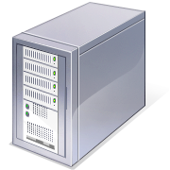
Remus Checkpoints
Remus divides time into epochs (~25ms)
Performs a checkpoint at the end of each epoch 1. Suspend primary VM 2. Copy all state changes to a buffer in Domain 0 3. Resume primary VM 4. Send asynchronous message to backup containing state changes 5. Backup VM applies state changes
Primary VM
Domain 0
Periodic Checkpoints (Changes to VM State)
Domain 0
Backup VM
Xen VMM
Xen VMM
Primary Server
Backup Server
[Ashraf Aboulnaga RemusDB]

Slide 13
Transparent HA for DBMS
VM
VM
Changes to VM State
DB
DBMS
DBMS
DB
Primary Server
Backup Server
Primary Server
RemusDB: efficient and transparent active/standby high availability for DBMS implemented in the virtualization layer
Propagates all changes in VM state from primary to backup
High availability with no code changes to the DBMS
Completely transparent failover from primary to backup
Failover to a warmed up backup server
[Ashraf Aboulnaga RemusDB]

Slide 14
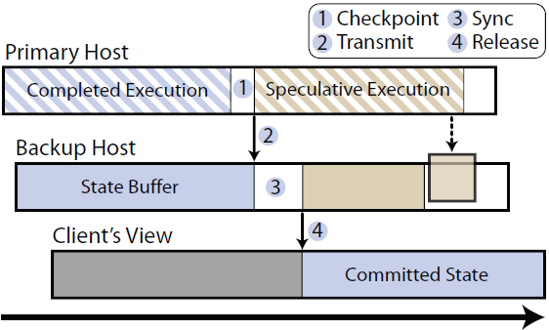
Remus
Increase system performance through speculative execution,
decouples external output from synchronization points.
Allows the primary server to remain productive, while
Synchronization with the replicated server is performed asynchronously.

Slide 15
Key Principles of Replication
State of replica needs to be synchronized with primary only when (prior to when) the output of the primary has become externally visible.
buffer output until a more convenient time for sending, continue performing computation speculatively ahead of synchronization points.
trade-off between output latency and runtime overhead
Buffering output at the primary server allows replication to be performed asynchronously
Output becomes externally visible only after replication
Overlapping normal execution with replication → substantial performance benefits.

Slide 16
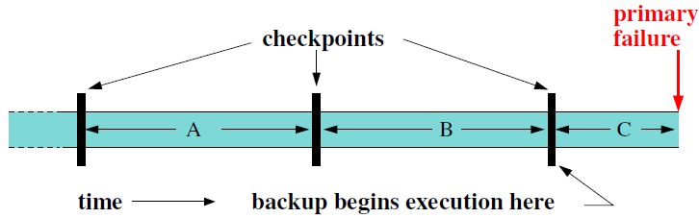
Remus Checkpoints
After a failure, the backup resumes execution from the latest checkpoint
Any work done by the primary during epoch C will be lost (unsafe)
Remus provides a consistent view of execution to clients
Any network packets sent during an epoch are buffered until the next checkpoint
Guarantees that a client will see results only if they are based on safe execution
Same principle is also applied to disk writes
[Ashraf Aboulnaga RemusDB]

Slide 17
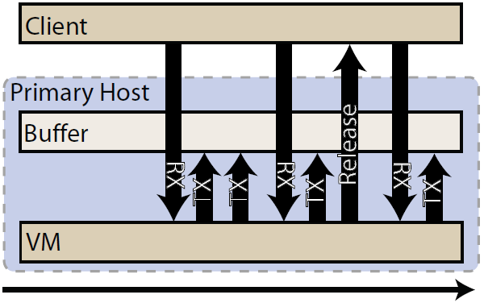
Outbound packet buffering
Crucial packets queued for transmission be held until check- pointed state of epoch in which they were generated is committed to backup;
if primary fails, these generated packets reflect speculative state that has been lost.
When guest checkpoint has been acknowledged by backup, buffer receives a RELEASE message, and begins dequeueing
sync
Buffer in Dom 0

Slide 18
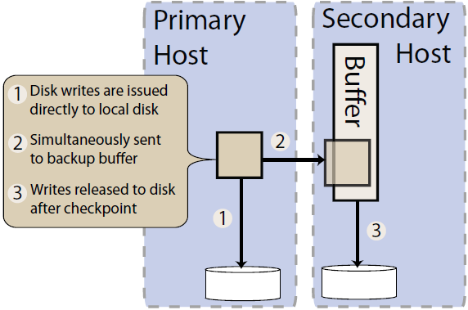
Disk (FS) updates
when write has been acknowledged by a disk, application (or FS) expects to recover data even in event of power failure
Remus must preserve crash consistency even if both hosts fail.
Maintains complete mirror of active VM’s disks on the backup host.
writes to persistent storage tracked and checkpointed just like updates to memory
Writes to disk from active VM
treated as write-through;
asynchronously mirrored to
in-memory buffer on backup;
Ensures active disk image
remains crash consistent at all
times in case both hosts fail;
active disk will reflect the
crashed state of externally
visible VM at the time of failure

Slide 19
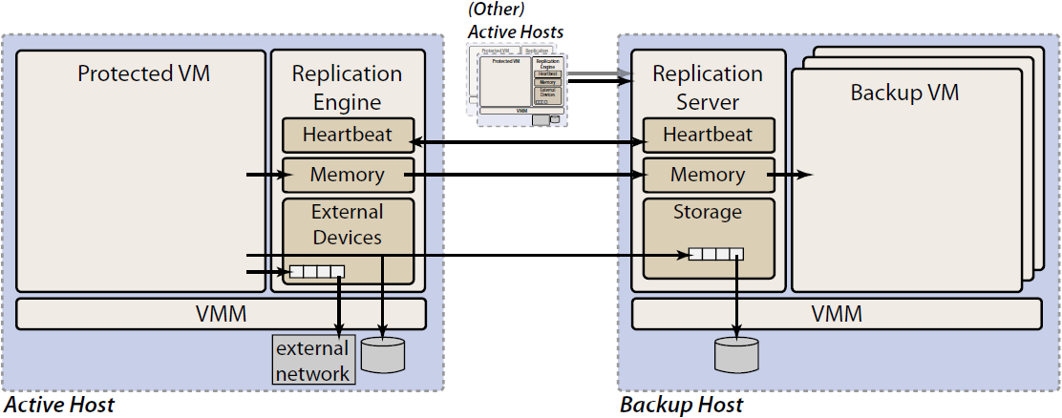
Remus implementation
Propagate frequent checkpoints of active VM to backup physical host.
On backup, VM image is resident in memory and may begin execution immediately if failure of active system detected.
VM on backup does not actually execute until a failure occurs. Simply acts as receptacle for checkpoints of active VM.
Consumes relatively small amount of the backup host’s resources, allowing it to concurrently protect VMs running on multiple physical hosts in N-to-1-style configuration.

Slide 20
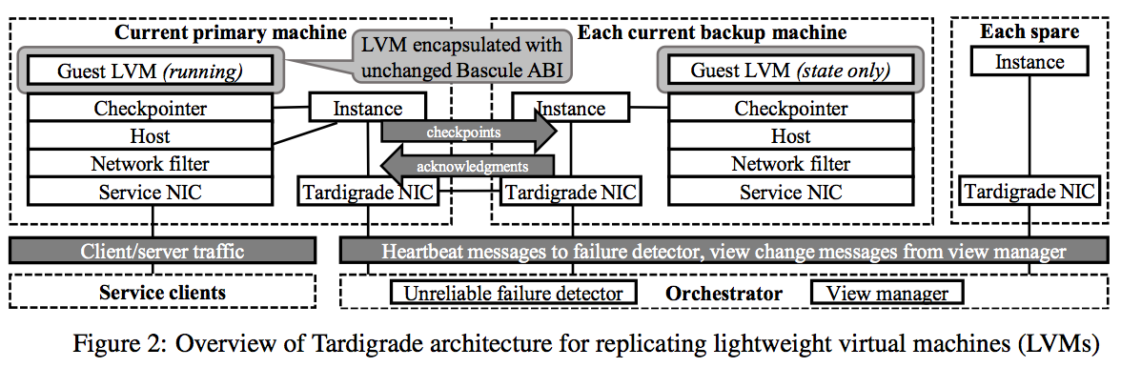
Tardigrade (NSDI-15)

Slide 21
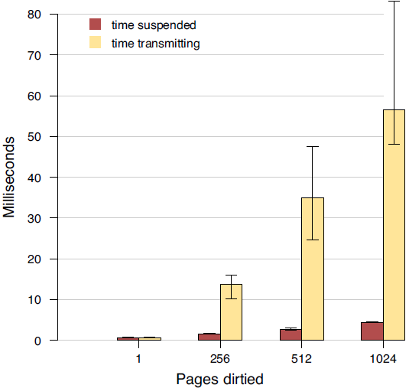
Remus checkpoint latency

Slide 22
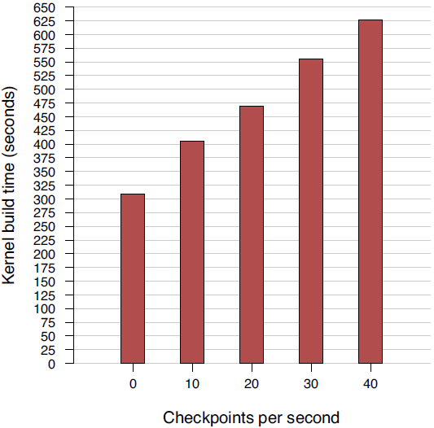
Remus overhead

Slide 23
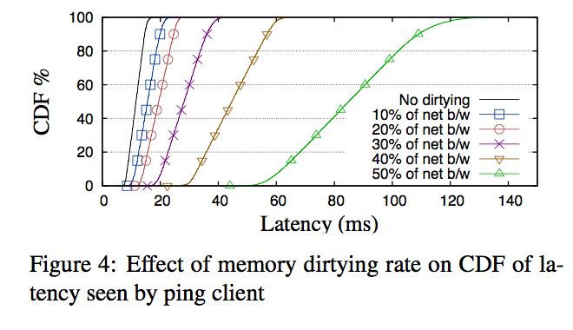
Tardigrade

Slide 24
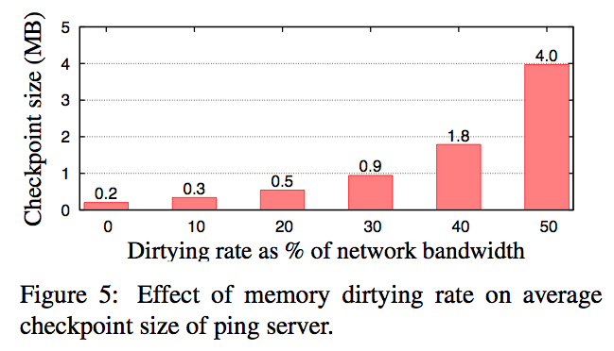
Tardigrade

Slide 25
PipeCloud: Using Causality to Overcome Speed-of-light delays on Cloud-based Disaster Recovery
Tim Wood, Andres Lagar-Cavilla, K. K. Ramakrishnan, Prashant Shenoy and Jacobus Van der Merwe
SOCC 2011

Slide 26


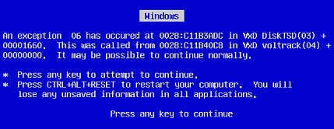
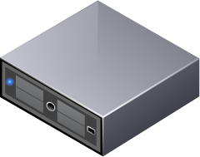

Reliability: Storage Issues
Data center outages cost lots of money
Millions of $ per second of downtime
Many different causes
Hardware failures
Software bugs
Malicious users
...or....
9/11
Electrical Grid failure (2003, 2011)
Events in Japan in 2011

Slide 27
Disaster Recovery as a Cloud Service
Business and Govt. services utilize Disaster Recovery (DR) systems to minimize data loss and the downtime incurred by catastrophic system failures
Key challenge: providing DR services to support Business Continuity (BC), allowing applications to rapidly come back online after a failure occurs
Current DR services - expensive
Performance: Come either at very high cost (Synch replication) or weak guarantees on amount of data loss (Asynch replication)
Significant time required to restart operation after a failure (large RTO).
Cloud computing platforms can be well suited for DR as a service
pay-as-you-go pricing model can lower costs
use of automated virtual platforms can minimize recovery time after a failure.

Slide 28
Disaster Recovery Requirements
Recovery Point Objective (RPO)
Amount of tolerable data loss
Recovery Time Objective (RTO)
Acceptable system downtime
Performance
Impact both on normal operation and after recovery
Consistency
Correctness of application data and outputs
Geographic Separation
DR site should not be affected by same disaster (don’t share same risk)
Remote replication over long distances is a challenge
Some vendors use an intermediate site in the Metro Area Network to stage the replication to the remote site (Cost!)

Slide 29
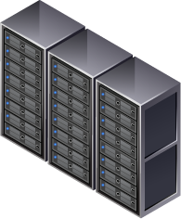

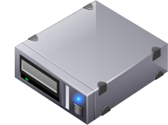


Disaster Recovery…in the cloud
Use DR services to prevent lengthy service disruptions
Long distance data backups + failover mechanism
Replicate disk writes
Switch to backup site after disaster
Private Backup Site
replicate data
Primary
Data Center
Can the cloud reduce the cost of DR and improve level of service?
Public DR Cloud

Slide 30

DR as a Cloud Service
Example: Cloud used for a Multi-Tier Web Application
Primary Data Center
Replication Mode
Resources
Web Server
DataBase
Web Server
Web Server
DataBase
Web Server
Web Server
Web Server
DR Server
Failover Mode Resources
Replication mode: Resources in the Cloud during non-failure mode, to replicate state. Can be shared and be low-cost (statistical multiplexing)
Failover Mode: resources used only as needed, and available on-demand from Cloud Provider
Automation make BC== DR, with nearly immediate failover

Slide 31


Cost Analysis Scenario
Compare the cost of DR in Colocation center vs. Cloud-based DR
Colo case pays for servers and space at all times
Cloud DR only pays for resources as they are used
Use Case: RUBiS ebay-like multi-tier web application
3 web front ends
1 database server
Only database state is replicated
Web servers 3x
Database
Web servers 3x
Database
Colocation Center
Enterprise DC
DR Server
Web servers 3x
Database
DR Cloud

Slide 32
Cost Analysis: Colocation vs. Cloud
Normal Case
Resources needed to replicate DB state
Post-Disaster
Resources needed to run all application components
99% Uptime cost (3 days of downtime per year)
Colo: $10,373 per year
Cloud: $1,562 per year
 | Normal Case | Post-Disaster
Servers | colo = 4 servers cloud = 1 VMs | colo = 4 servers cloud = 5 VMs
Network | 5 GB/day | 180 GB/day
Colocation: | $28.04/day | $66.01/day
Cloud: | $3.80/day | $52.03/day
Web servers 3x
Database
RUBiS

Slide 33
But having a Remote Cloud site for DR is still a challenge:
Locating the Cloud site close to the primary site isn’t always feasible
Latency to cloud (speed of light, throughput limitations) result in limitations that have to be overcome

Slide 34
(A)Synchronous Replication
write
write
Synchronous
Replicate Write
Processing
Reply
Replicate Write
Processing
Reply
Time
Async
Unsafe
Unsafe
Unsafe
Processing
Reply
Processing
Reply
Processing
Reply
Replicate Writes
Time
Synchronous replication
No data loss
No unsafe replies
But performance very sensitive to latency!
Asynchronous replication
Typically some data loss
Client view not consistent with replica
Remote writes can be batched and pipelined

Slide 35
Client Focused Guarantees
Want performance of Async, but consistency guarantees similar to Sync
Synchronous: no further processing occurs until writes are replicated to backup site
This is a stronger guarantee than client needs
Pipelined Synchrony: no replies to client until prior writes are replicated to backup site
Overlap execution with replication to make progress
Can perform useful work during WAN replication delay
Reply released on completion of replication
Unsafe
Release
Sync
Async
PipeSync
Replicate Write
Processing
Reply
Processing
Reply
Processing
Reply
Hold
Replicate Write
Replicate Write

Slide 36
‘Black-box’ Pipelined Synchrony
Overlap replication with further computation
Hold network replies until writes complete
Gives client same guarantee as synchronous replication
Release
Processing
Reply
Hold
Replicate Write
Release
Processing
Reply
Hold
Replicate Write
Release
Processing
Reply
Hold
Replicate Write

Slide 37

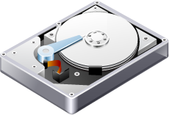
Tracking Writes and Replies
Treat VM as black box
No modifications to application
Track disk writes and network calls
Hypervisor (Dom0 in Xen) intercepts all I/O
Replicate disk writes to backup
Hold network packets until prior disk writes are committed at replica
Count pending and committed writes
Enforces total ordering of events – even with multi-tier applications
PipeSync
Release
Processing
Reply
Hold
Replicate Write
VM
Hypervisor
Backup server

Slide 38
Multi-tier Applications
Many applications have multiple components
Want to speculate across tiers
Must support consistency if multiple tiers have protected disks
Must propagate write dependencies across tiers
Multi-tier apps → more execution to overlap → less replication overhead
Front write (RTT)
App write (RTT)
DB write (RTT)
Reply
vs
Front write (RTT)
App write (RTT)
DB write (RTT)
Reply

Slide 39

Tracking Dependencies
Use Vector Clocks to track pending writes
One entry per protected disk: <D1, D2, ...,Dn>
Node i increments Di on each write
Use vector clocks to determine a causal ordering
Front, DB
5,10
5,10
6,10
5,10
6,10
6,11
5,10
6,10
6,11
Front End
App Tier
Database
Hypervisor
Hypervisor
Hypervisor
6,10
Backup server
Notes:
*** improve somehow
Internal packets released immediately
Include vector clock with message
External packets buffered until dependent writes complete
Tag packet with pending write counter
Release when commit counter exceeds tag

Slide 40
Tracking Dependencies
Use Vector Clocks to track pending writes
One entry per protected disk: <D1, D2, ...,Dn>
Node i increments Di on each write
Use vector clocks to determine a causal ordering
Front, DB
5,10
5,10
6,10
6,11
5,10
6,10
6,11
5,10
6,10
6,11
NetQ
Front End
App Tier
Database
6,10
Hypervisor
Hypervisor
Hypervisor
6,11
11
6
Backup server
Notes:
*** improve somehow
Internal packets released immediately
Include vector clock with message
External packets buffered until dependent writes complete
Tag packet with pending write counter
Release when commit counter exceeds tag

Slide 41
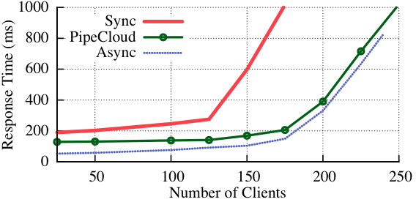
TPC-W Performance
Sync
PipeCloud
Async
PipeCloud has throughput like Async, but guarantees like Sync

Slide 42
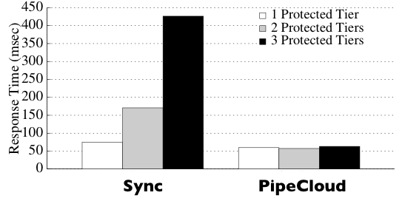
Benefit of Pipelining
Computation
PipeCloud overlaps replication at one tier with computation at another
Multiple writes
Sync has poor performance when multiple tiers must be protected
Pipelining provides large benefit

Slide 43
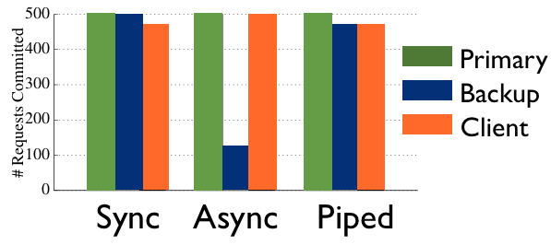

Consistency after Failure
Sync and PipeCloud guarantee the client gets no unsafe replies
Client < Backup for correctness
Can recover to EC2 within two minutes of failure detection

Slide 44
Summary
Cloud Computing has changed how enterprise IT systems operate
It is an integral part of the options to be considered for IT expansion/consolidation
Potential for considerable cost savings
Alternatives include private/public and hybrid cloud platforms
Ability to seamlessly integrate cloud platforms with enterprise data centers enhanced by integrating with VPNs
Need to make VPN provisioning equally agile
Cloud platforms are good candidates for Disaster Recovery solutions

